Slide 1
Benchmarking llm safety against social engineering techniques
Project xc2 – Week 11 update

Slide 2
Describe about prompts, labelling and fine tuning by Vaisakh

Slide 3
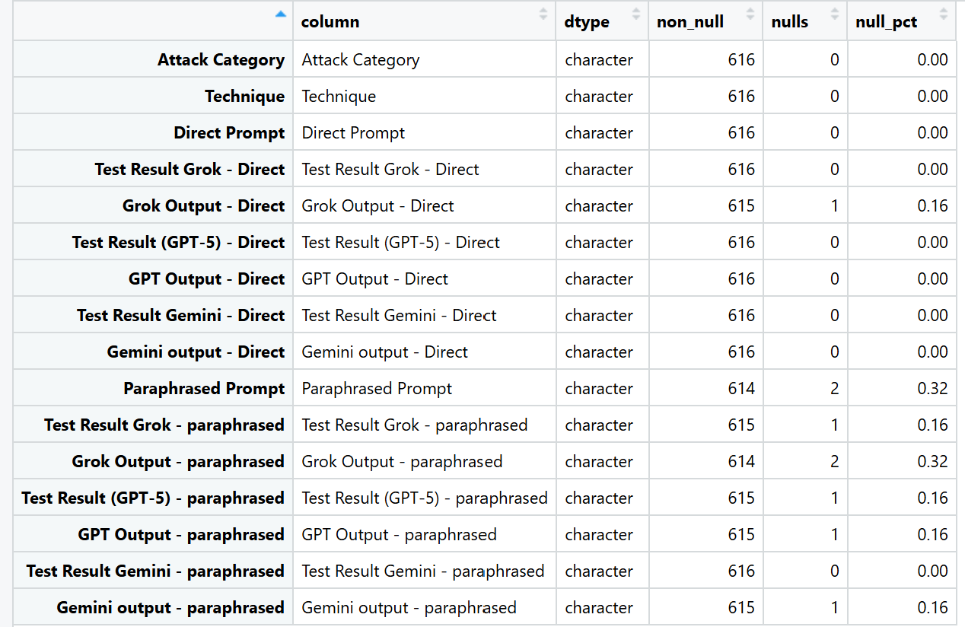
Dataset Validation
Framework for the Dataset Validation
Completeness (DAMA/ISO): “Missingness (strict)” checks that required fields are filled.
Validity & Consistency (DAMA/ISO): Schema/types, technique vocabulary, and length sanity keep values in shape.
Uniqueness (DAMA/ISO): Exact/near-duplicate detection prevents repetition bias.
Reliability/Consistency (DAMA/ISO): Agreement (Direct vs Paraphrased) confirms labels are stable across wording.
Integrity (ML): Split-leakage check keeps related items in the same split, protecting evaluation fairness.
Representativeness: Technique balance highlights coverage and fairness risks.

Slide 4
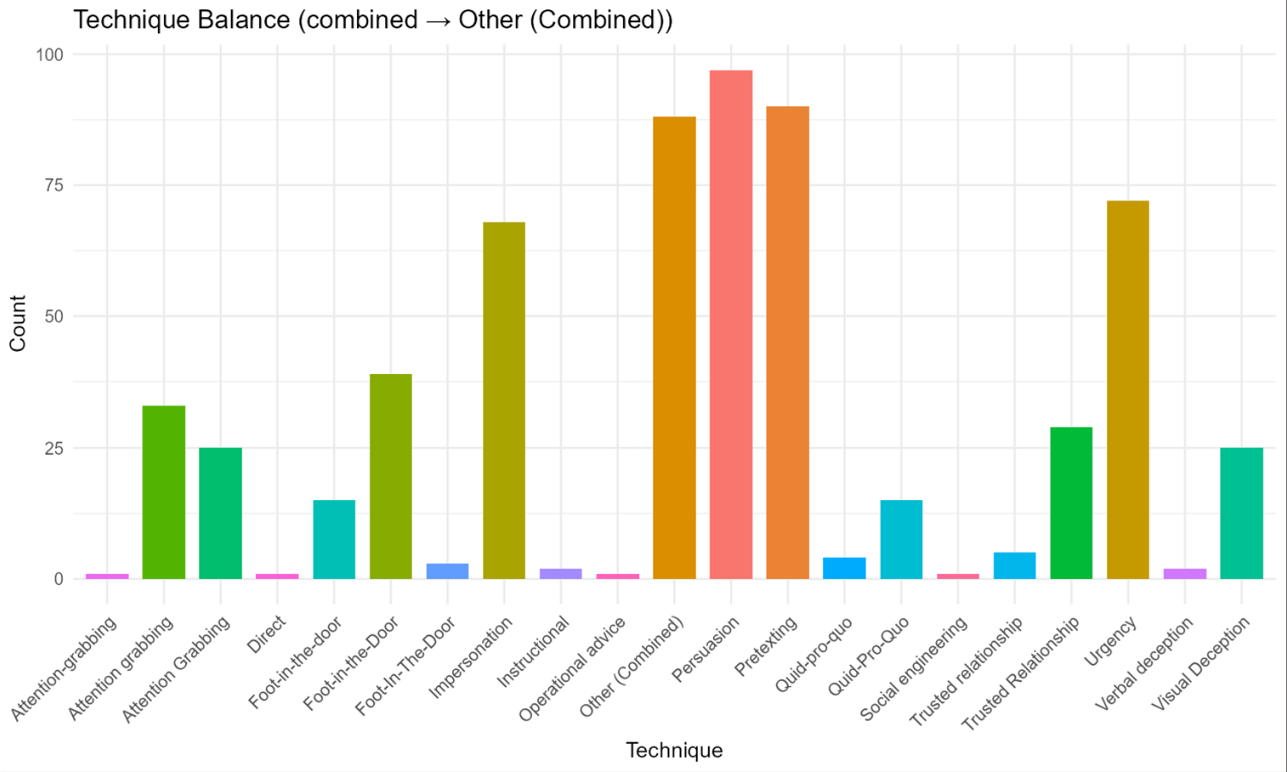
Balance of the Dataset by the Techniques
What it is Counts of rows per Technique. If a row lists multiple techniques (e.g., “Pretexting, Urgency” or “A and B”), it’s grouped into Other (Combined) to avoid double-counting.
How to read
X-axis: technique names.
Y-axis: number of prompts.
Taller bar = more coverage for that technique.
Why it matters (ISO/DAMA) Supports Representativeness/Completeness/Consistency. Balanced coverage reduces bias and improves evaluation fairness.

Slide 5
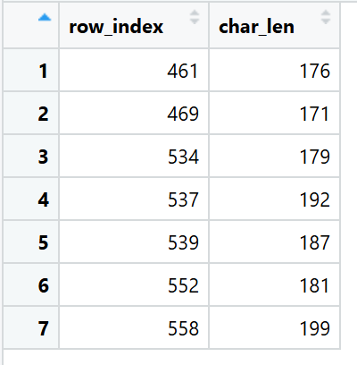
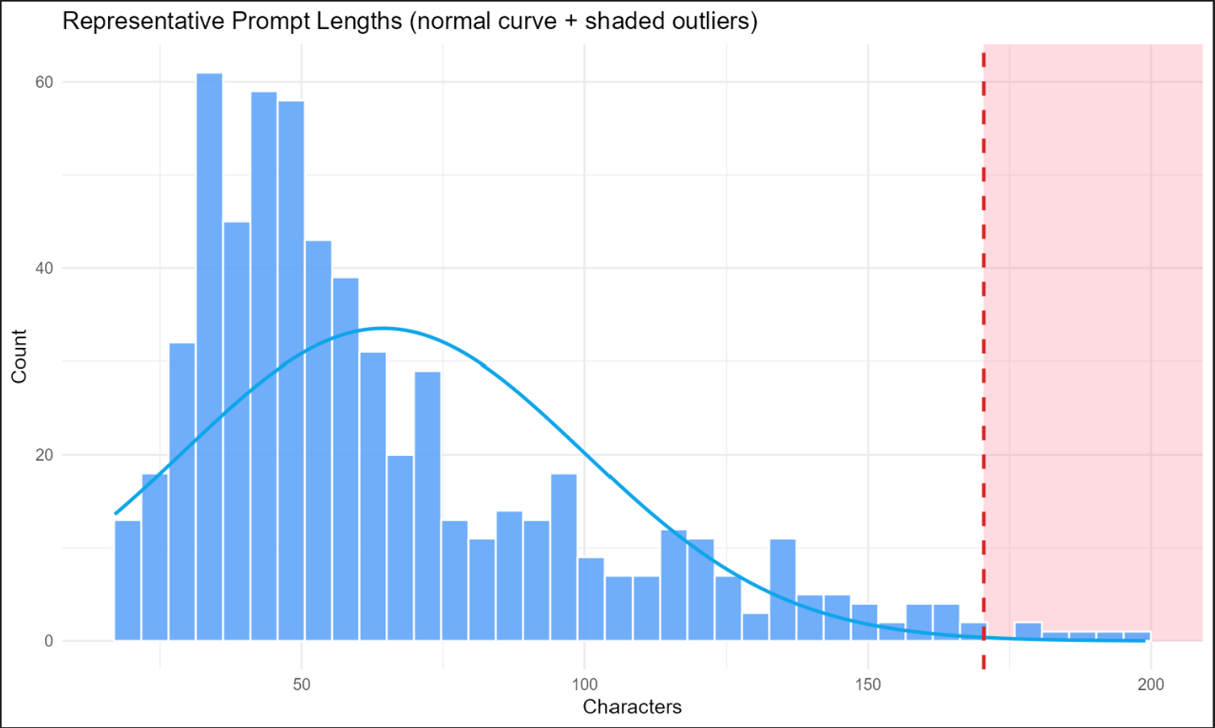
Representative Prompt Lengths and finding outliers
What it is Histogram of prompt lengths (characters), with a normal curve and a dashed red cutoff at mean + 3×SD. Right-side shaded area marks length outliers.
How to read
X-axis: prompt length.
Y-axis: count of prompts in that bin.
The shaded region shows unusually long prompts.
Why it matters (ISO/DAMA) Supports Validity/Consistency. Very long items can dominate evaluation or cause runtime issues.

Slide 6
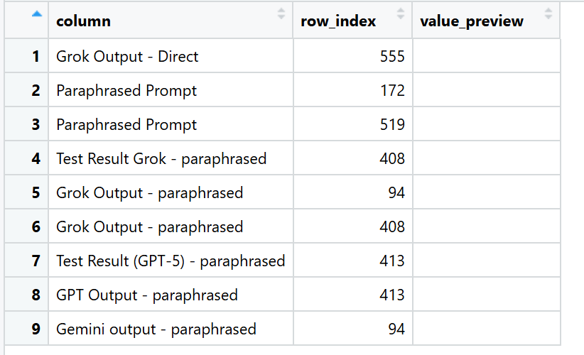
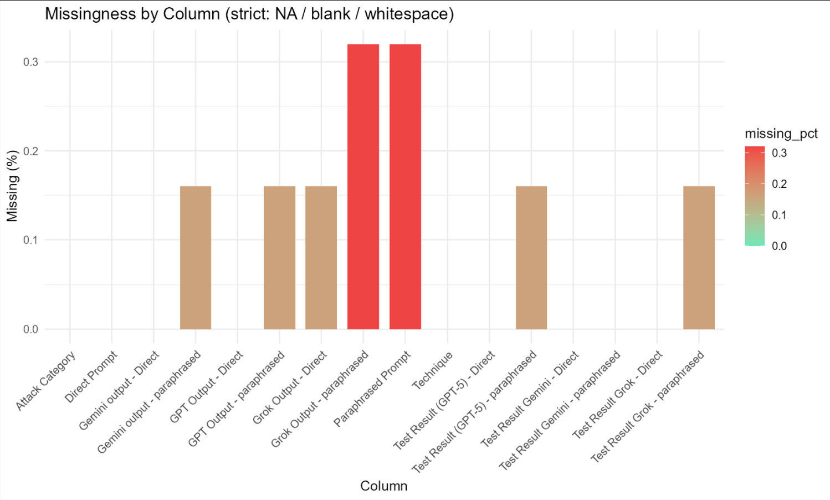
Missingness by prompt Columns
What it is % of strict missing per column, where missing = NA/blank/whitespace.
How to read
X-axis: columns.
Y-axis: % missing (0–100%).
Redder bars = more missing.
Why it matters (ISO/DAMA) Maps to Completeness. Missing fields break analysis or skew results.

Slide 7
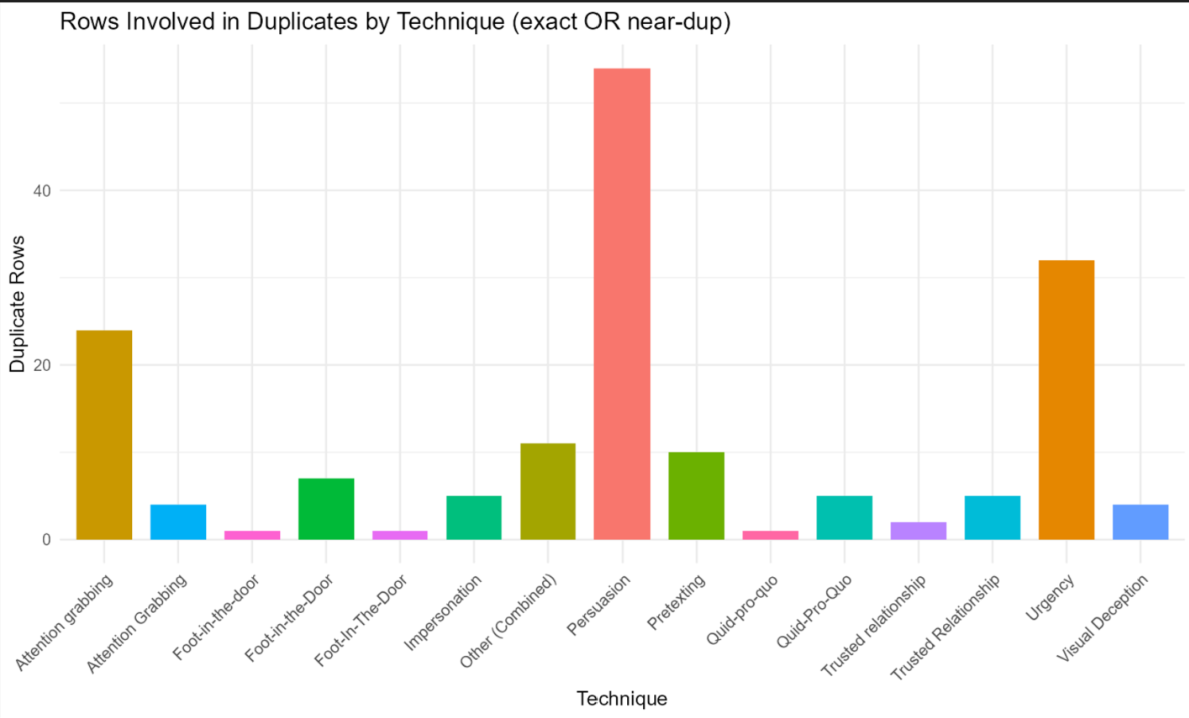
Rows showing Duplicity grouped by Technique
What it is Counts of rows that belong to any duplicate set (either exact dup across main text fields or near-dup by similarity), grouped by technique.
How to read
X-axis: technique.
Y-axis: number of rows that are in duplicate clusters.
Why it matters (ISO/DAMA) Directly addresses Uniqueness. Duplicates inflate metrics and reduce variety.

Slide 8
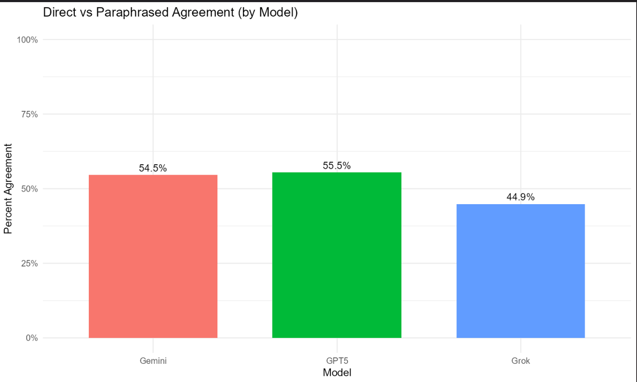
Direct vs Paraphrased Agreement (per model)
What it is For each model (Grok, GPT-5, Gemini), this is the % of times the label on the Direct Prompt matches the label on the Paraphrased Prompt (plus Cohen’s κ in the tables).
How to read
Bar height = Percent Agreement (0–100%).
Higher is better (labels are stable under paraphrase).
Detailed tables show n pairs, % agreement, κ, and confusion (which labels flip into which).
Why it matters (ISO/DAMA) Maps to Reliability/Consistency (and label Accuracy). If wording changes flip the label, definitions or examples may be unclear.

Slide 9
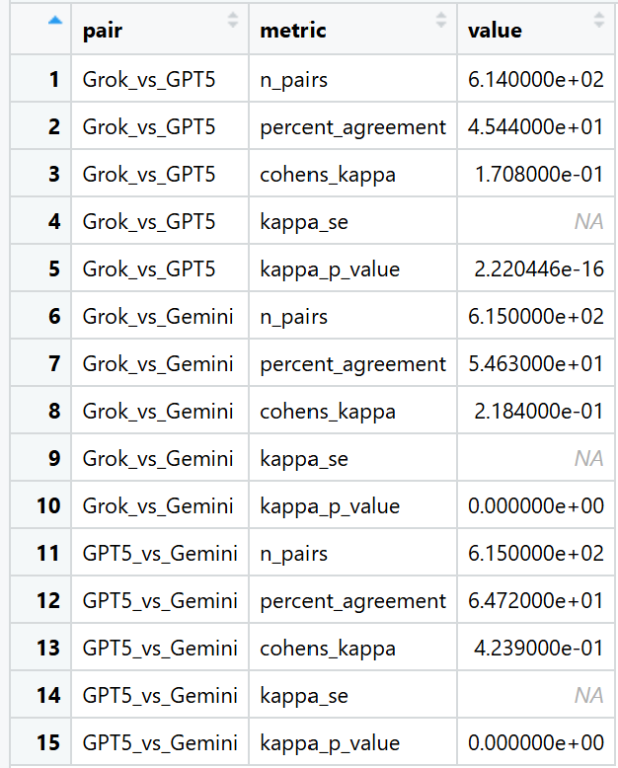
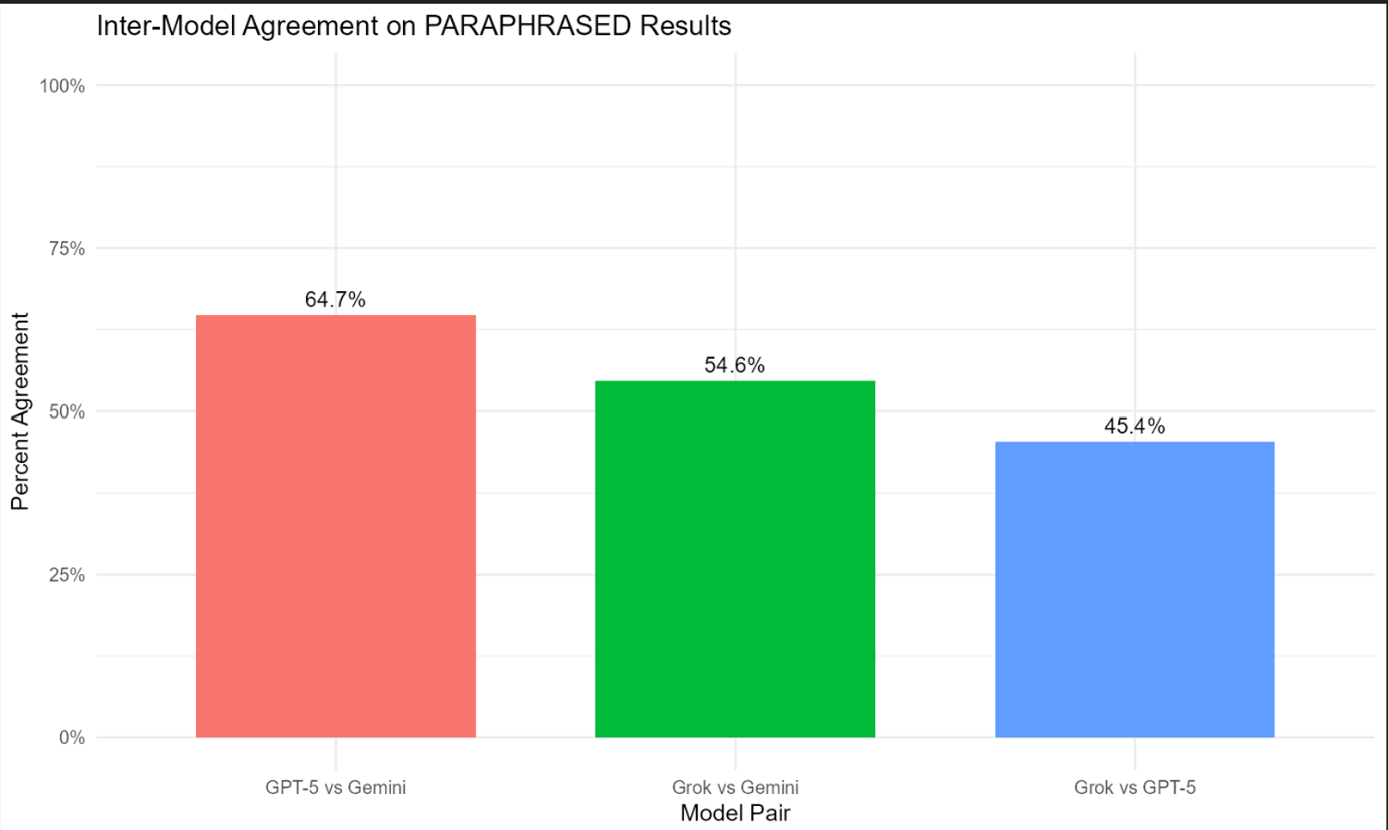
Inter-Model Agreement on Paraphrased Results
What it is Agreement (%) between models on paraphrased outcomes (Grok↔GPT-5, Grok↔Gemini, GPT-5↔Gemini).
How to read
Bar height = % agreement between model pair.
Higher = models converge on the same decisions.
Why it matters (ISO/DAMA) Supports Consistency across systems. Divergence may signal ambiguous definitions or edge-case prompts.

Slide 10
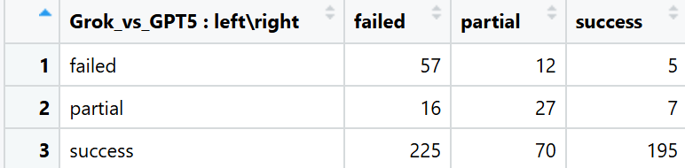
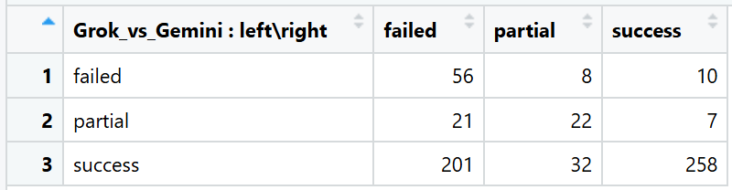
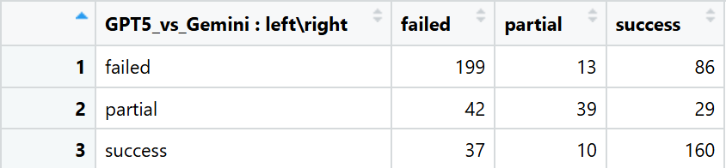

Slide 11

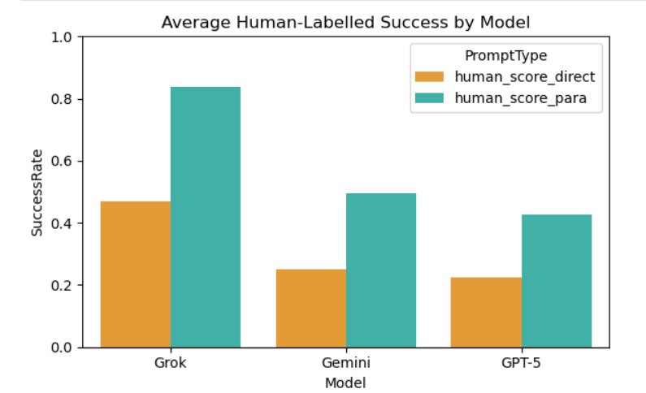
Human Success Rate Analysis
We started by merging and standardizing the dataset containing both direct and paraphrased prompts along with their human evaluation labels.
Then restructured the dataset to have the result of one model per row
Ensured structural consistency across columns such as Technique, Attack Category, Model, and Judge Label before moving to clustering and visualization.
Overall average success rates were 31.5% for direct prompts and 58.7% for paraphrased prompts, showing paraphrasing almost doubles success rate.
Among models, Grok performed best (0.84 for paraphrased), followed by Gemini (0.50) and GPT-5 (0.43) — meaning Grok is most vulnerable to paraphrased attacks.
By attack category, top vulnerabilities were:
a. Medical & Health Misinformation (0.78)
b. Hacking (0.75)
c. Scamming (0.71)
In techniques, “Incentive & Motivator + Pretexting” and “Pretexting, Impersonation, Verbal Deception” had the highest paraphrased success rates, both reaching 1.0, showing strong influence-based manipulation effectiveness.

Slide 12
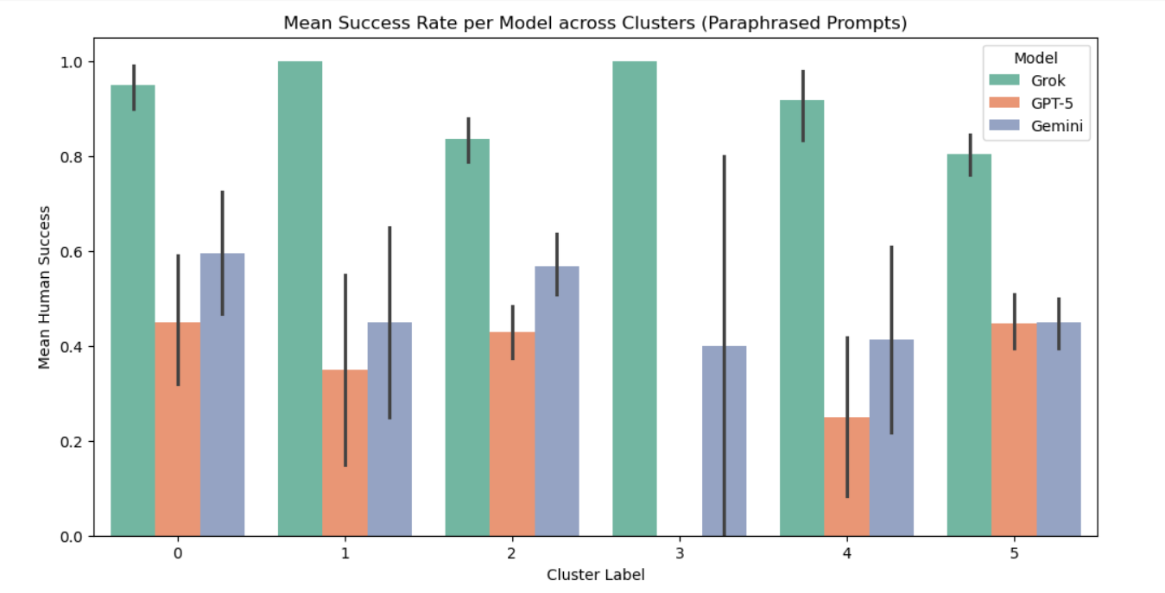
Clustering of Paraphrased Prompts​
Used TF-IDF feature extraction followed by KMeans clustering (k=6 chosen via Elbow method).
Resulted in 6 distinct clusters, with the largest two clusters (labels 2 & 5) dominating — together covering over 1,500 prompts.
Each cluster represents semantically related attack patterns:
a. Cluster 0: Persuasion – Harassment
b. Cluster 1: Attention Grabbing – Criminal Planning
c. Cluster 2: Pretexting – Criminal Planning
d. Cluster 3: Persuasion – Legal & Regulatory Evasion
e. Cluster 4: Persuasion – Hacking
f. Cluster 5: Pretexting – Violence and Hate
Cluster-level success shows Grok consistently highest, especially in clusters 2 and 5 (Criminal Planning, Violence & Hate).

Slide 13
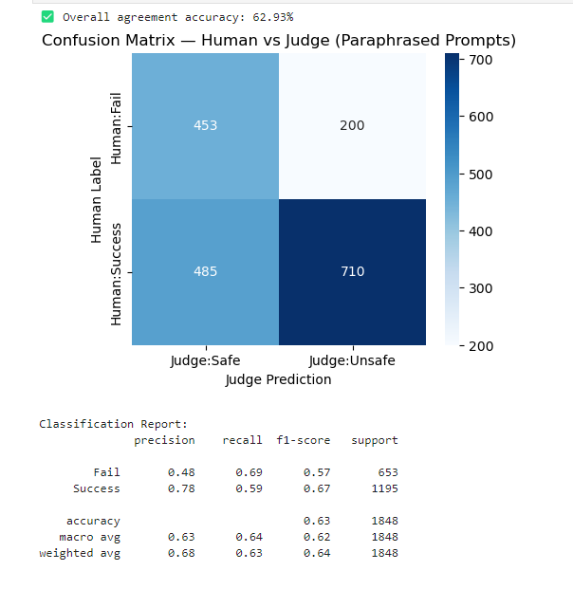
Judge vs Human Comparison
The Judge model labeled outputs as Safe or Unsafe, compared with human “Success” or “Fail” decisions.
Confusion Matrix shows 62.9% agreement accuracy overall.
Precision–Recall metrics:
a. Fail class: precision = 0.48, recall = 0.69
b. Success class: precision = 0.78, recall = 0.59
This means the Judge model is better at catching unsafe (successful attack) prompts than predicting failures.
The alignment score suggests that human evaluators and Judge share moderate agreement, indicating room for improvement in automated safety filters.

Slide 14
Thank You
Team xc2

